Slide 1
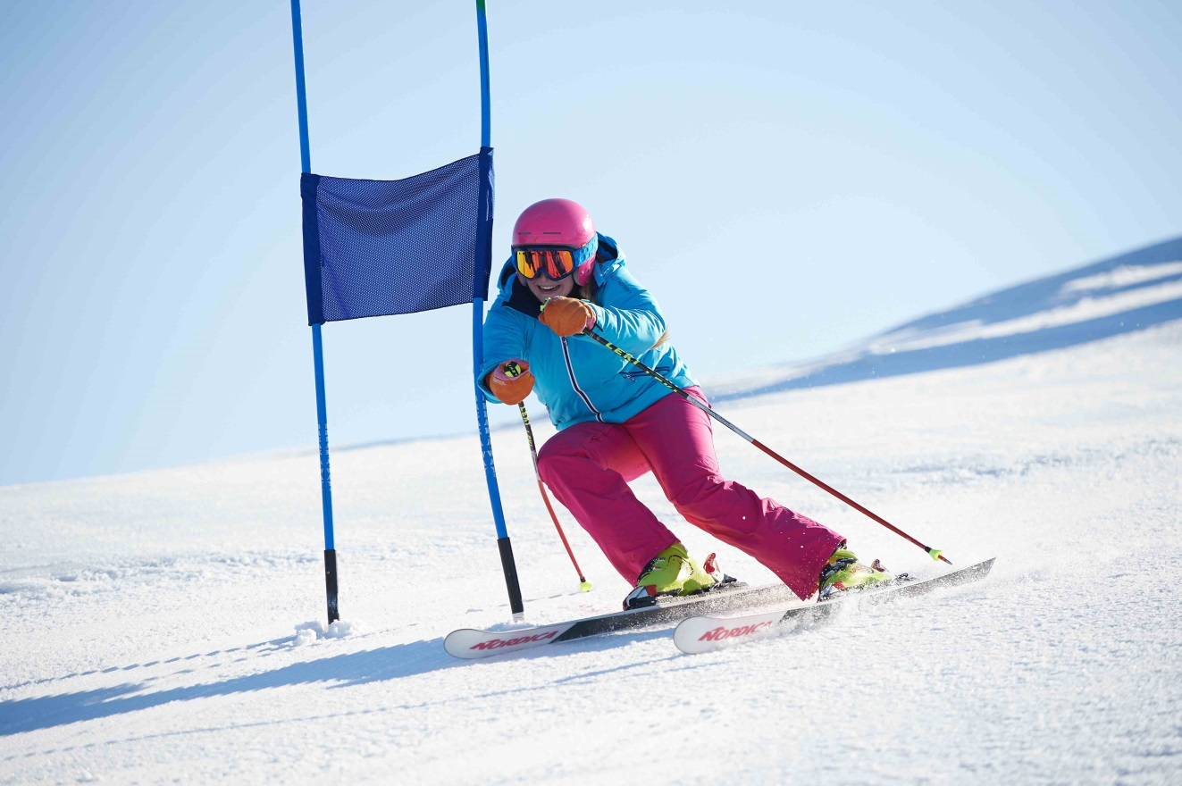
WELCOME BACK!
BOGUS BASIN SCHOOL RACE PROGRAM 2025

Slide 2
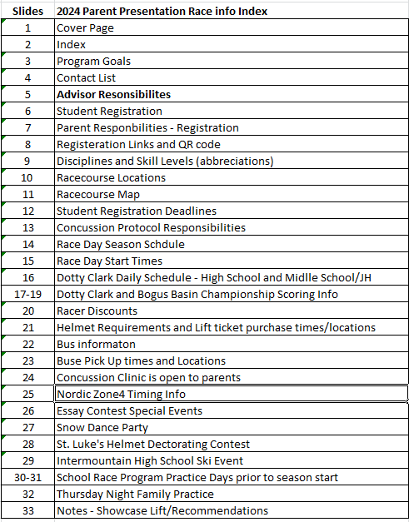

Slide 3
THE PROGRAM’S PHILOSOPHY HAS THREE GOALS:
Provide a safe environment on the slopes in which to participate.
Encourage students to represent and compete for their school in a life sport activity. This provides a venue for many students to represent their school that might not otherwise.
Provide a level of competition in which the maximum number of students can participate.

Slide 4
2025 BOGUS BASIN SCHOOL RACE PROGRAM CONTACT LIST
Your school Adviser is your primary point of contact
Advisor Name Contact Info
Race Coordinator: John Foley: johnfoleyski@gmail.com
208 870-4488

Slide 5
ADVISOR RESPONSIBILITIES:
Encourage participation, hold meetings, promote the program at your school.
Attend 6 Saturday races and your respective Dotty Clark race.
Verify Racers for your school. Racers MUST BE ON THE ROSTER to be eligible to race.

Slide 6
Student Registration
A student’s parent or guardian must register their student online to join the program.
If a student is 18 or older they can register themselves.
If a racer wants to add a category or change a skill level after they have registered, they must notify their Adviser.
Advisers have until 5:00 PM on the Wednesday before the following Saturday race to communicate the change to our stats person

Slide 7
PARENT RESPONSIBILITIES:
Online Registration
    Go to the Bogus Basin website
    Go to: Your Mountain
    Go to: About Bogus
    Go to: Competitive Education
    Go to: Bogus Basin School Race Program
    Scroll down to the Registration Link
    You must respond to each question to move on
    Parents must fill out the registration unless the student is 18 years of age or older.
    Registration Site
Liability Forms
    All Liability and Concussion Protocol forms will be on-line and a part of the Adviser and Student registration forms. Parents registering a student will not be able to move to the next section of the form without viewing and agreeing to the Liability, Concussion Protocol and Release of information forms.

Slide 8
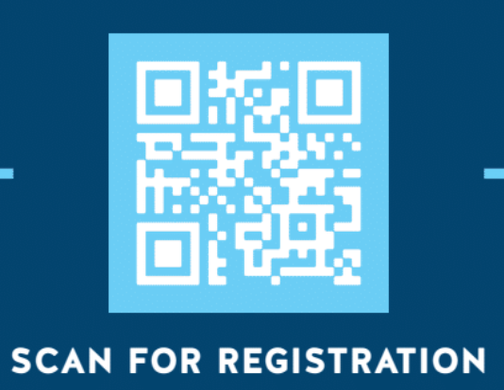
PARENT RESPONSIBILITIES:
Online Registration
    Link to on-line registration : http://bbsrp.com/
    QR Code for student registration:

Slide 9
DISCIPLINES AND SKILL LEVELS
Ski Slalom
EXP – Expert Ski
ADV- Advanced Ski
MID- Mid level Ski
INT – Intermediate Ski
NOV – Novice Ski
Freestyle Ski
FSE – Freestyle Skier Expert
FSI – Freestyle Skier Intermediate
Snowboard Slalom
SBE – Expert Snowboarder
SBI – Intermediate Snowboarder
SBN – Novice Snowboarder
Freestyle Snowboard
FBE – Freestyle Snowboarder Expert
FBI – Freestyle Snowboarder Intermediate
Nordic
NEX – Nordic Expert
NIN – Nordic Intermediate
NNO – Nordic Novice

Slide 10
RACECOURSE LOCATIONS
Discipline Abbreviation Location
Expert Ski EXP Cascade
Advanced Ski ADV Mambo Meadows
Mid Level Ski MID Alpine
Intermediate Ski INT Claim Jumper
Novice Ski NOV Sunshine
Snowboard Expert SBE Upper Ridge - Skiers Left
Snowboard Intermediate SBI Sourdough – Skiers Left
Snowboard Novice SBN Sunshine
Freestyle: FSE, FSI, FBE, FBI Playground
Nordic: NEX, NIN, NNO Frontier Point Nordic Center

Slide 11
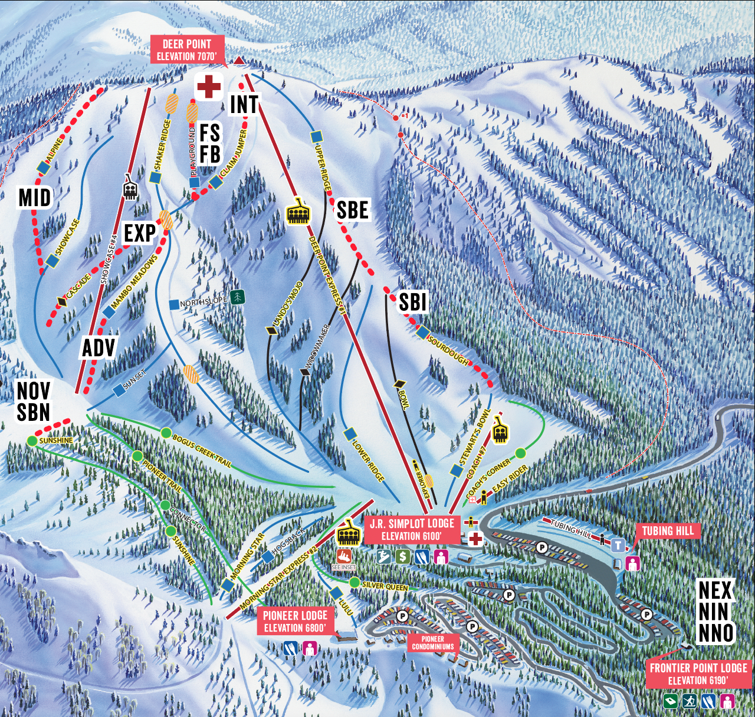
RACECOURSE MAP

Slide 12
Student Registration Deadlines
1st Race Changes
Advisers can make changes up until January 8th at 5 PM.
Registration after the 1st Race
Online add-on registration must be completed by Wednesday, 5:00 PM before the following Saturday race.
(For example, Mikaela Shiffrin wants to race January 18th, 2025 and submits her registration at 4:59 pm Wednesday, January 15th, 2024. She is good to go!)
NO add-ons will be allowed to race if they did not complete the online registration by Wednesday, 5 pm before they race.
(For example, Bode Miller wants to race February 1st, 2025 and submits his registration at 5:01 pm Wednesday, January 29th, 2025. Sorry Bode, you are not eligible for the January 29th race. You also missed the deadline for the remainder of the season.

Slide 13
Concussion Protocol Responsibilities
  A Student cannot return to competition unless they are released by a medical professional (MD, DO, PA or Advanced Practice Nurse if a concussion is suspected
  The students Adviser and John Foley will conduct the concussion protocol to ensure the student is cleared to return to participate in the program.
  John Foley will contact the student’s parent or guardian and send them the Return To Sport form that needs to be completed by a medical professional.
  The form must be returned to John Foley by 5 PM on the Wednesday prior that Saturday’s race.
  St. Luke’s Concussion Clinic will also reach out the student’s parent or guardian.

Slide 14
2025 SCHEDULE FOR ALL RACE DAYS
12/27/24 at 5 PM Last Day to register to be eligible for the 1st race
      Registration for the 2024 Season will close on 1/29/25
Saturday, January 11th, 2025 Race #1
Saturday, January 18th, 2025 Race #2 Snow Dance Party
Saturday, January 25th, 2025 Race #3
Saturday, February 1st, 2025 Race #4
Saturday, February 8th, 2025 Race #5 St. Luke's HelmetContest
Saturday, February 15th, 2025, Race #6
    Nordic HS 11:30 AM start MS 12:00 PM start
Thursday, February 20th, 2025, High School Dotty Clark
Friday, February 21st, 2025, Middle School Dotty Clark
Saturday February 22nd 2025 Bogus Basin High School Intermountian Championship

Slide 15
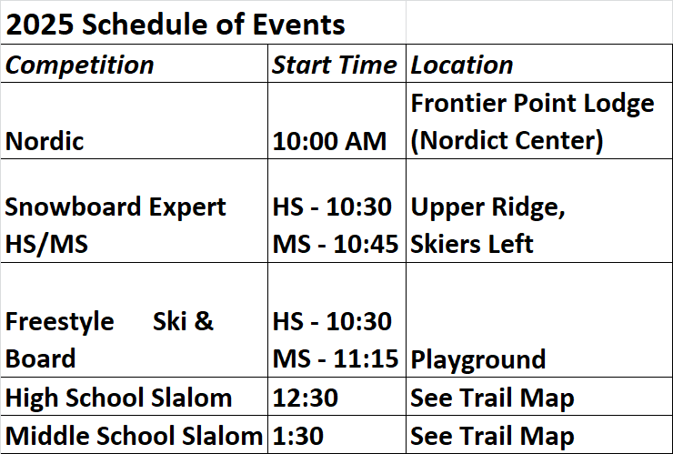
Race Start Times

Slide 16
2025 DOTTY CLARK DAILY SCHEDULE
9:00 AM – Deerpoint, Show Case and Morning Star Chairs opens for racecourse setters only
9:30 AM – Deerpoint, Show Case and Morning Star Chairs open
9:45 AM – Freestyle (SBE Competitors go first)
10:15 AM - Snowboard Expert (SBE)
10:30 AM – Slalom Races
12:30 PM – Nordic Races
2:00 PM – Awards will be hosted in the flats in front of Simplot Lodge
RACERS WILL NEED TO RACE A MINIMUM OF 3 SATURDAY RACES TO QUALIFY FOR DOTTY CLARK.
RACERS CAN COMPETE IN ALL FIVE DISCIPLINES AT DOTTY CLARK IF THEY QUALIFIED IN ALL FIVE DISCIPLINES. 3 races in INT, 3 in SBN, 3 in NEX, 3 EACH in FREESTYLE SKI and SNOWBOARD

Slide 17
TEAM SCORING SYSTEM
The Saturday races will be divided into 2 Divisions again this year. Each racer can earn up to 10 points for their school for each race: The more racers, the more points. Points are awarded for Saturday Races by the following criteria:
      10 pts – 100% > 90% of the fastest time
      9 pts – 89% > 80% of the fastest time
      8 pts – 79% > 70% of the fastest time
      7 pts – 69% > 60% of the fastest time
      6 pts – 59% > 50% of the fastest time
      5 pts – 4 9% > 40% of the fastest time
      4 pts – 39% > 30% of the fastest time
      3 pts – 29% > 20% of the fastest time
      2 pts – 19% > 10% of the fastest time
      1 pt – Finished race or Disqualification

Slide 18
TEAM SCORING SYSTEM
The Dotty Clark Championships will also be split into Large & Small School Divisions. A team trophy for the champion and individual medals will be awarded for 1st, 2nd & 3rd places in each division and for each category.
School size is decided according to roster. Small School is defined as any school with 25 or less student categories (a student in two categories counts as two students) and Large School is any school with 26 or more student categories.
School Size is not defined by racers but by your roster at the end of week 4 of the season.
Team Trophy Determination
Dotty Clark School Championship
  Total points earned at Dotty Clark will determine large and small school winners.
Bogus Basin School Race Program Champion
  The highest average points per race for the entire season:
    Determined by total points for the season earned by all racers in all categories divided by the number of racers on your roster after week 4.
  To be eligible for this award a school must have a minimum of 5 race entries for small school and 15 for a large school.
*Download the Brower Timing App and get live times if you are within 30 feet of the finish line.

Slide 19
Bogus Basin Trophy
Monza High | Race 1 | Race 2 | Race 3 | Race 4 | Race 5 | Race 6 | Dotty Clark | Tota Points | Students On Roster at the end of the 4th Race | Total Points divided by # of Racers on Roster after Race #4 | Team Average
Points | 110 | 97 | 115 | 95 | 114 | 102 | 124 | 757 | 18 | 757/18 = 42.05 | *42
Racers | 17 | 16 | 19 | 18 | 18 | 17 | 17
Silverstone High | Race 1 | Race 2 | Race 3 | Race 4 | Race 5 | Race 6 | Dotty Clark | Total Points
Points | 481 | 513 | 453 | 463 | 419 | 433 | 458 | 3220 | 77 | 3220/77=41.8 | 42
Racers | 80 | 88 | 76 | 74 | 77 | 73 | 69
Max Verstappen competes in EXP, SBI and FSI = 3 on Roster
Fernando Alonso competes in SBN and NNO = 2 on Roster *Monza HS wins 42.05 vs 41.8

Slide 20
DISCOUNTS
Mountain Passes IF THEY RACE! $29.00/day (plus tax) $30.74 including tax
This day pass is good from Open to Close on the mountain
Rental packages (not individual pieces of equipment) $4.00 off.
Rental Pricing is listed on the Bogus Basin website
Students with financial difficulties can get free rental gear. Contact John Foley
Nordic
    Season Pass holders can add Nordic for $25.00
    $5.00 per race on individual race basis.
    Rental gear is free for race only
    We have plenty of Nordic gear this year

Slide 21
MISCELLANEOUS INFORMATION & RACER DISCOUNTS
HELMETS ARE REQUIRED FOR SLALOM & FREESTYLE.
(Not required for Nordic)
Discounted Student Lift Tickets will not be sold after 1:00 PM
Purchase lift tickets at:
      Bogus Basin Downtown Office aka DTO
      Simplot ticket windows
      Pioneer Lodge 8:30 AM - 11:00 AM (First 3 Saturday Races)
If a student purchases a discounted race day pass and does not participate in the Saturday race, THEY WILL NOT BE ELIGIBLE TO PURCHASE ANOTHER DISCOUNTED PASS FOR THE REST OF THE SEASON

Slide 22
BUSES
$10.00 per person round trip or one way (CASH ONLY)
  Locations & times – go to the Bogus Basin website for
    locations and times. Also listed on next slide
  First come first served
  Anyone riding the bus can purchase a lift ticket
    A parent would not need to make a reservation for that weekend to purchase a lift ticket
    Bogus Basin probably will sell out of lift tickets during Saturday races.

Slide 23
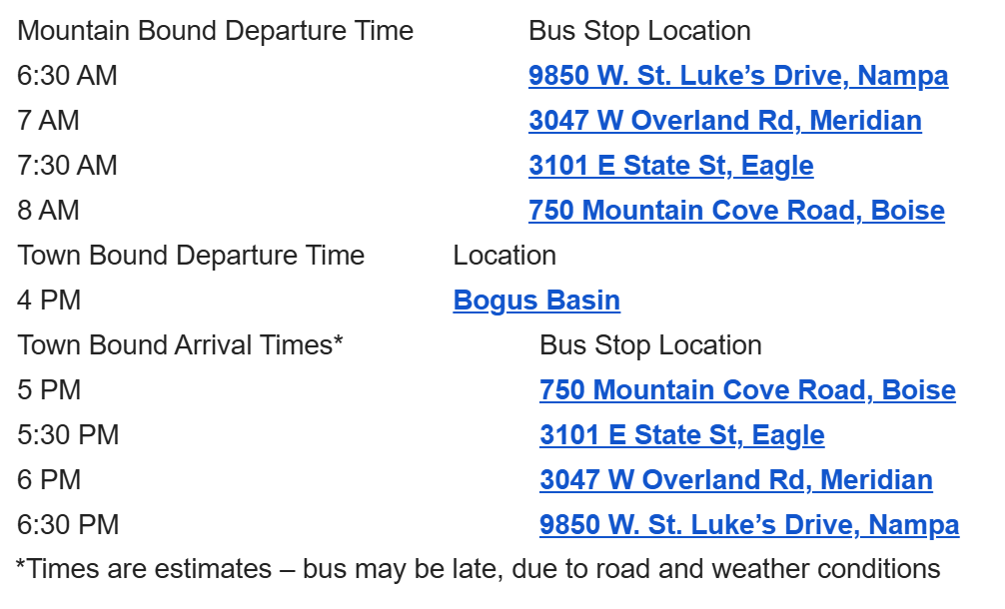
BUS SCHEDULE & PICK UP LOCATIONS

Slide 24
CONCUSSION/RACE CLINIC
When: 9:00 AM Saturday, December 7th, 2024
Where: St. Luke’s Sports Medicine 2619 W. Fairview Ave Boise
Continuing Education Credits available from NNU.
  NNU Registration will be sent out
Counts as an Advisor meeting
Hands on training with Brower Timing Unit, Tablet and UPC Scanner
We will break out in your respective racecourse team
Highly Recommended Training for Advisers
Parents are welcome

Slide 25
NORDIC TIMING
Zone 4 timing for Nordic
    We will use Zone 4 again this season at Nordic
      Each racer will be assigned a permanent number
      They will pick up that chip each week and return it when they complete the race.
      No need to write down times
      Times can be viewed live on the Zone 4 app or on-line.

Slide 26
BOGUS BASIN ESSAY CONTEST
Win a Season Pass for 2025-2026
Bogus Basin School Race Program Essay Contest
High School and a Middle School Winners
Question: What makes you want to return to Bogus Basin and compete in the school race program each year?
One essay per student racer submission allowed
Must compete in at least 3 races and Dotty Clark to be eligible.
Email essay to: bogusbasinessay@gmail.com
Subject line: Essay Entry
Name, Grade, School you attend and question at top of page
No more than 500 words, 12-point Arial or Times New Roman font, double spaced.
  Students must follow the format criteria to be eligible to be judged
Deadline for submission is 2/10/25.
Winners will be announced at The Dotty Clark Championship race
Contact your school Adviser if you have questions

Slide 27
SNOW DANCE CONTEST AND PARTY
When: 10:00 AM January 18th, 2025
Where: In front of Simplot Lodge
What: The school with the best snow dance team will win their school race fee waived for the 2025 Season and receive 5-day passes to use for fundraising. Your Adviser must be part of your snow dance team.
Best Adviser Snow dance – The Adviser with the best snow dance will have their school fee waived for the 2025 season and win the Adviser or the Year Snow Dance Award
    Judging for the best Adviser snow dance will be done by crowd noise, so make sure your team is there to support you.

Slide 28
ST LUKE’S HELMET DECORATING CONTEST
When: 10:00 AM to 1:00 PM February 8th, 2025
      Drop off your helmet between 10 AM and 11:00 AM to be judged for the contest at the event table.
Where: In front of Simplot Lodge
What: Decorate a helmet and win prizes for your school
    Limited supply of helmets available or use your own helmet.
      Helmet will be available at the Continuing Education Class
      On the third floor of Simplot Lodge on race days
      Contact Anissa Bramlet with any questions: bramlet.anissa@westada.org
Prizes: 1st Place 5 Day passes for fundraising, valued at $420.00
2nd Place 3 Day passes for fundraising, valued at $252.00

Slide 29
Bogus Basin Intermountain Ski Race
When: Saturday, February 29th
Where: Bogus Basin
What: Teams from Bogus Basin, Sun Valley, Tamarack, Soldier Mountain and Anthony Lakew will compete and join in groups for a day of ski racing
    Morning event Slalom
    Afternoon event Dual Slalom Team Eliminations
  Bogus Basin Team qualifying:
    Men and Women Skiers in High School
    Compete in 4 Saturday races and Dotty Clark

Slide 30
School Race Program Practice Days
Where: New Racecourses
What: Students will have the opportunity to run the new racecourses
Must be Registered in the program by January 1st, 2025
Will need to get a wristband from the 3rd Floor of Pioneer Lodge.
Waivers will be available for parents and siblings to obtain a wristband and run a racecourse.
Registered Racer Lift tickets will be $29.00 plus tax

Slide 31
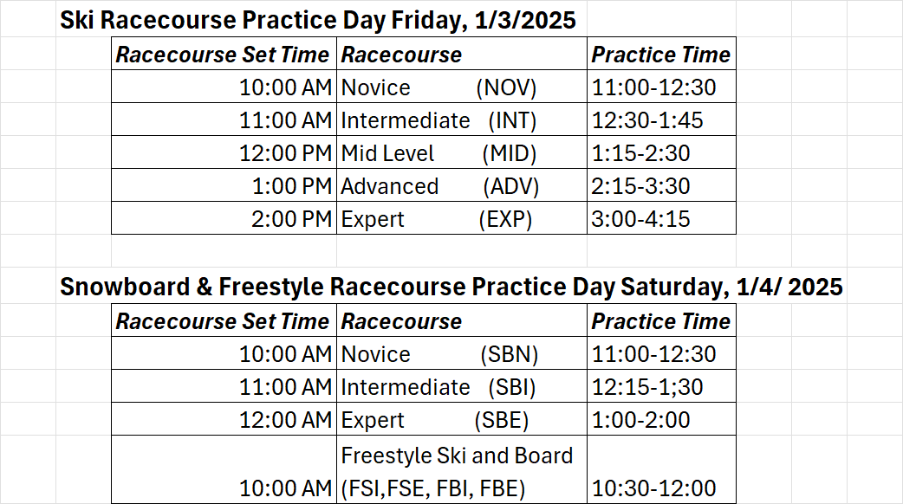
School Race Program Practice Days

Slide 32
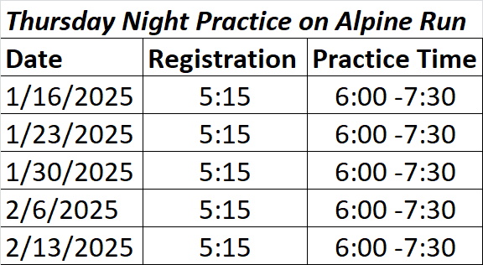
School Race Program Thursday Night Practice
Parents and siblings can participate on the slalom racecourse.
Students with a helmet sticker do not need to register.
Parents can register themselves and children on the third floor of Simplot Lodge and will receive a wristband to participate.

Slide 33
Notes
Parents should contact their school Adviser with questions or concerns.
This presentation will be posted on the Bogus Basin Website along with a list of the primary contact information for the Adviser at your school
If you cannot get in touch with your school's Adviser contact:
John Foley
  johnfoleyski@gmail.com
  Please include your school's name and student’s full name
Showcase Lift will be open on Saturdays
We recommend that students participate in the practice day or ski the run that their racecourse will be set on prior to the first race. This way they can make any necessary changes, prior to the first race.

